Slide 1
eFontys
Security Programming
Radu Alexandru, Raditya Surya Pratama, Georgiana Manolache, Armin Roushan, Jan-Niklas Schneider, Nina O’Driscoll

Slide 2
Security breaches have been increasing considerably over the last decade, becoming an everyday problem for both low and high-profile organizations.

Slide 3
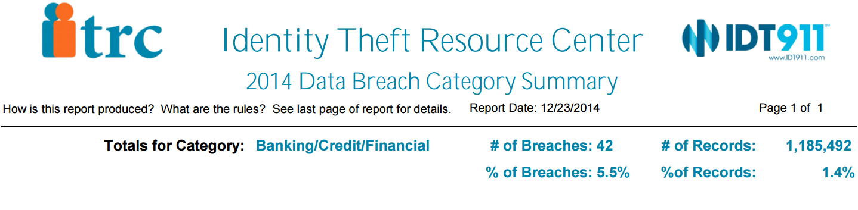
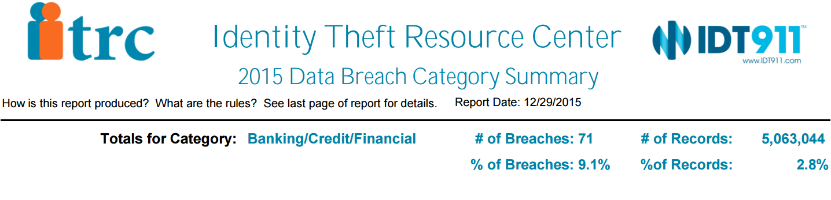
Banking breaches Summary 2014-2015

Slide 4
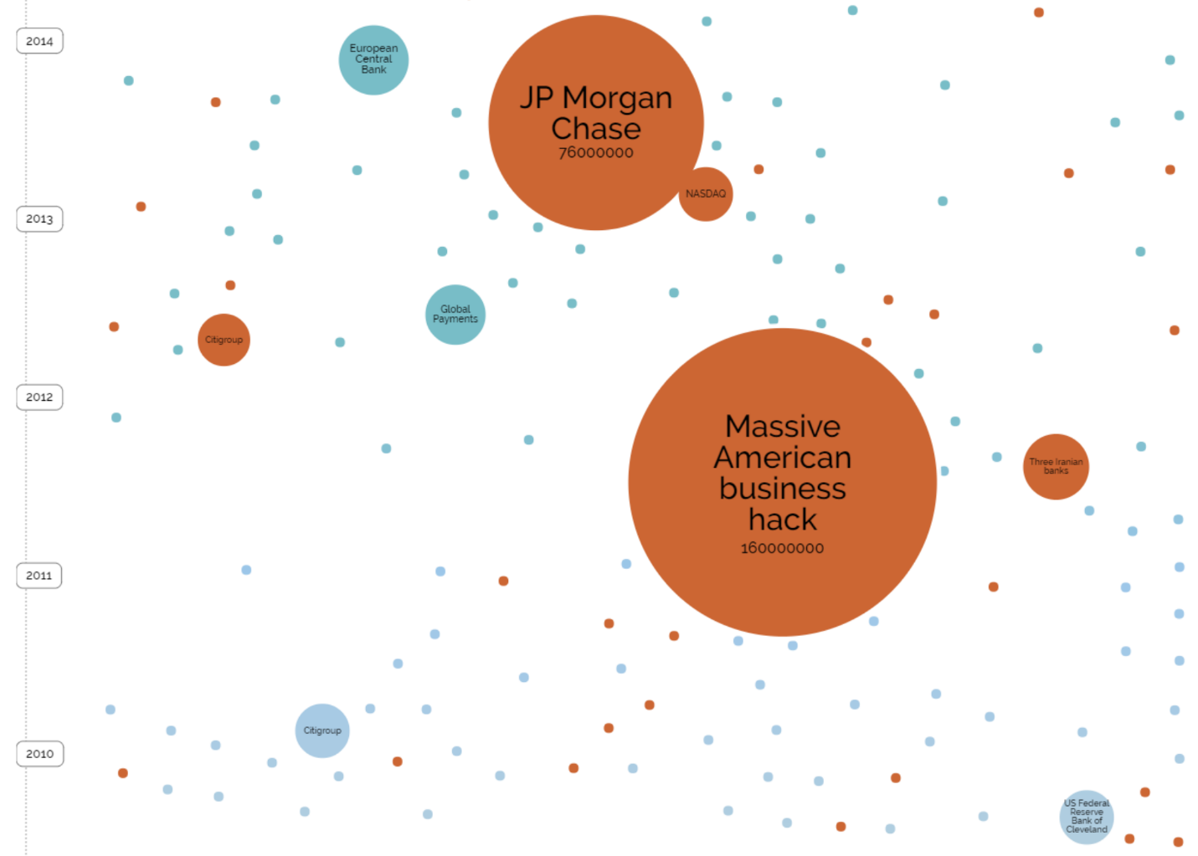
Notes:
Among the affected financial services organizations there is JP Morgan Chase, European Central Bank, US Federal Reserve Bank of Cleveland, Citigroup

Slide 5
eFontys Demo

Slide 6
Pen-Test Findings

Slide 7
Cloud Service
Features:
Register.
Login.
Upload files.

Slide 8
Path Traversal
Vulnerability found using Nikto software
CloudserviceSite/SePrWebsite/index.php/sips/sipssys/users/a/admin/user:
SIPS (Simple Internet Publishing System) v0.2.2 allows user account info (including password) to be retrieved remotely.

Slide 9
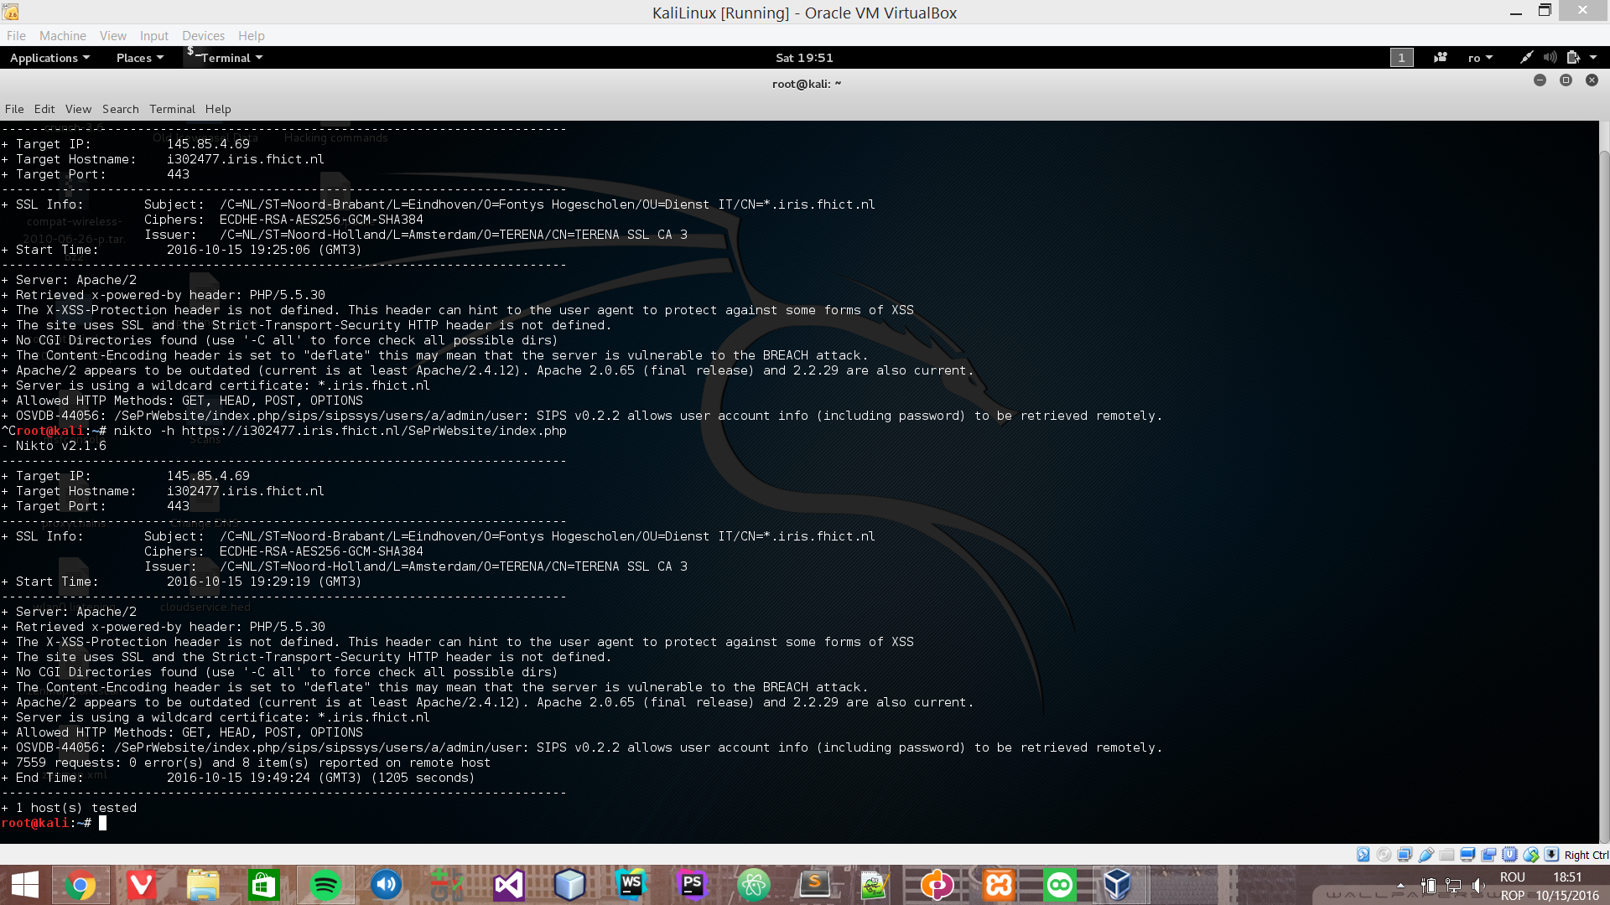

Slide 10
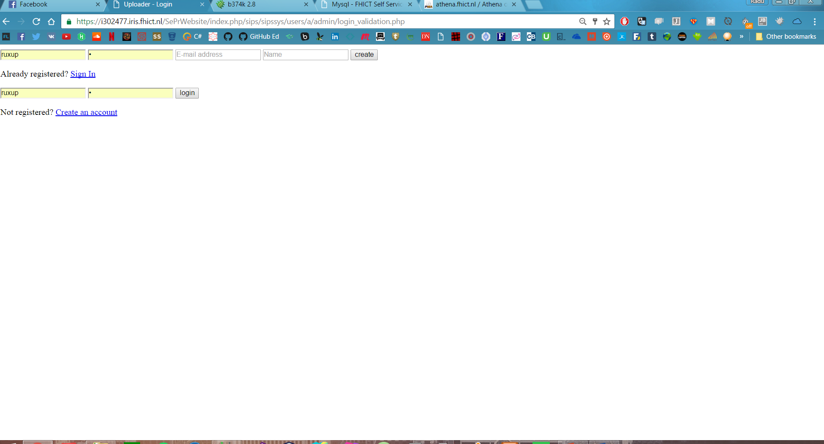

Slide 11
XSS Vulnerability
Web Browser XSS Protection is not enabled, or is disabled by the configuration of the 'X-XSS-Protection' HTTP response header on the web server

Slide 12
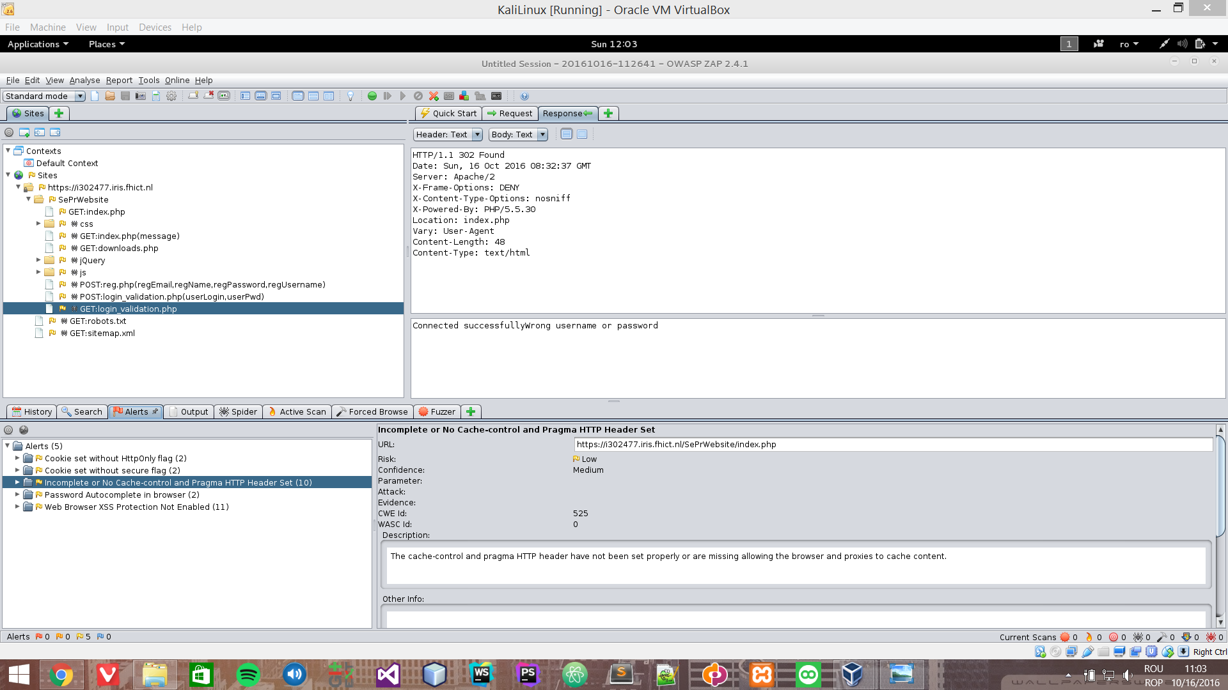

Slide 13
Brute Force attack
Password length, No password encryption.

Slide 14
Upload Vulnerability
We were able to upload a shell as a PHP file on the Cloud server and we got access to the whole server.

Slide 15
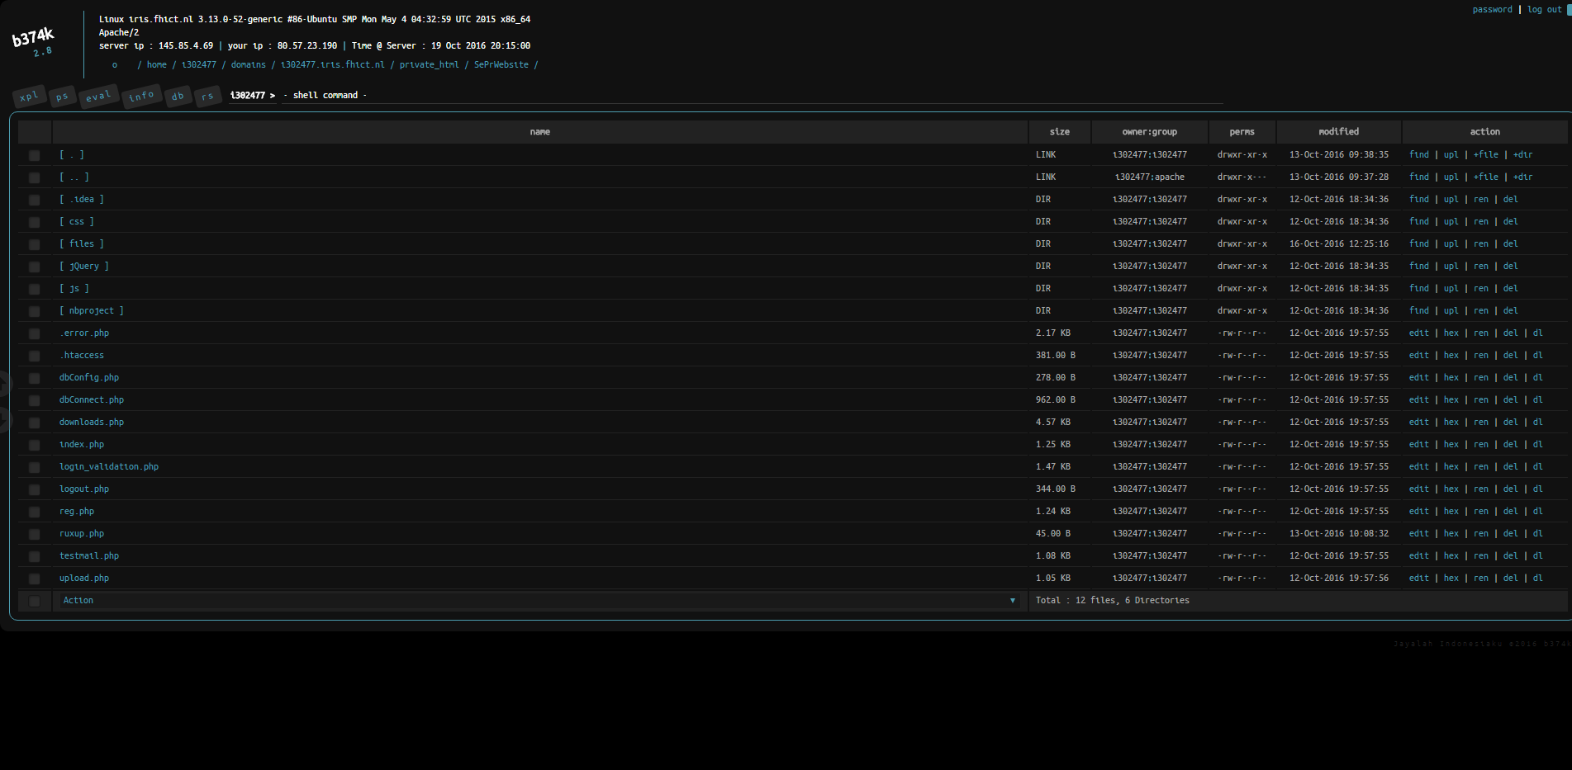

Slide 16
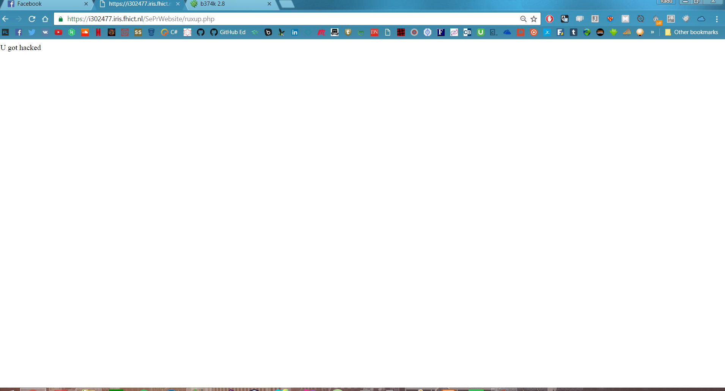

Slide 17
Conclusion

Slide 18
Add functionality
Prevent malicious

